Slide 1
Data Collection & Cleaning
Week 3 and Week 4 Updates
https://github.com/aditya0x404/AQIpredict.git

Slide 2
WEEK 3
Collected weather data of the major cities in India
The data spans from 2019 to 2024.
The data includes 24 major cities of India.
The weather data includes:
Maximum and Minimum Temperature
Precipitation (mm)
Wind speed (km/h)
Humidity
The data consists of daily weather data for each city.

Slide 3
Data Collection
Data was
collected using the open-meteo API.
The link for the API is provided for reference
https://open-meteo.com/en/docs/historical-weather-api
This API is free to use and provides historical weather data for every city from around the world.
Weather Data

Slide 4
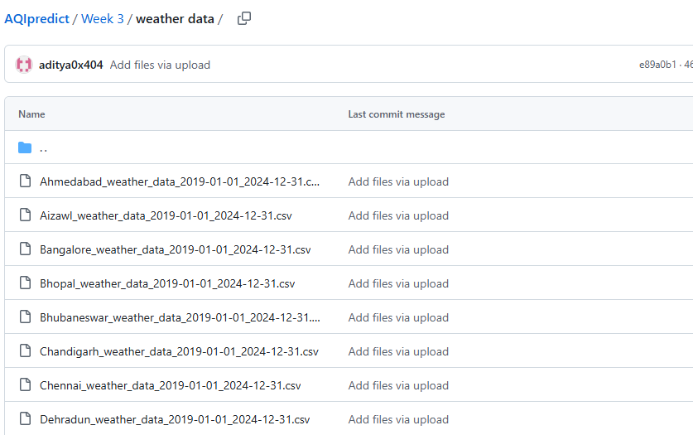

Slide 5
WEEK 4
Air quality data was collected for the cities from various stations inside the city.
The datasets are ranged from 2020 to March 2025.
The data contains everyday data of the major pollutants using which AQ is calculated.
The pollutants using which AQ is calculated is given below:
PM2.5 (Particulate Matter < 2.5 microns)
PM10 (Particulate Matter < 10 microns)
NO2 (Nitrogen Dioxide)
SO2 (Sulfur Dioxide)
CO (Carbon Monoxide)
O3 (Ozone)

Slide 6
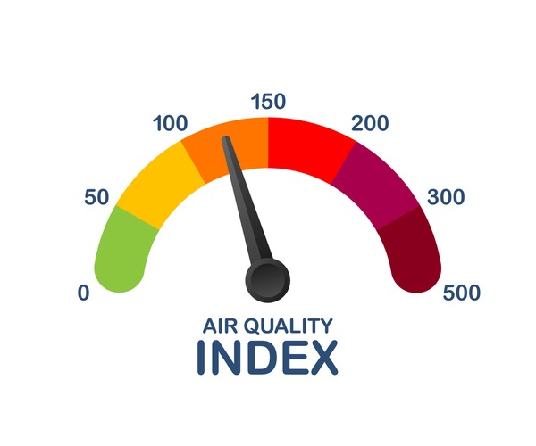
Data Collection
The data was collected from https://aqicn.org/historical database which contains historical AQ data from different stations inside the city.
The data was collected for 15 major cities of India.
The dataset contained missing values which was processed using the Numpy and pandas library.
The data preprocessing was done using the Google Colab env.

Slide 7
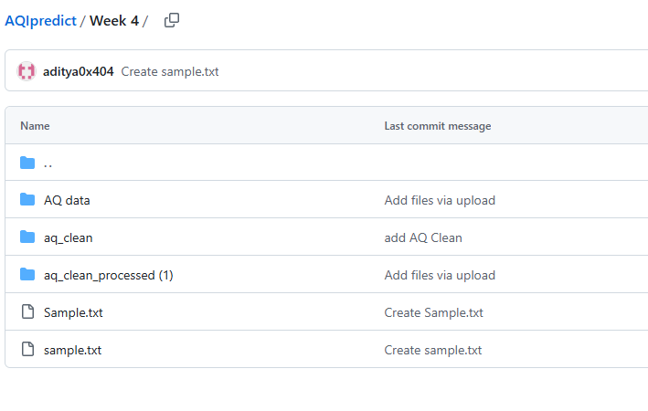

Slide 8
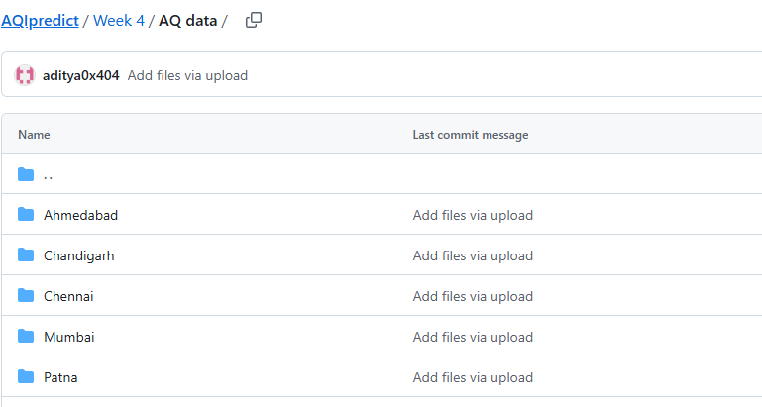

Slide 9
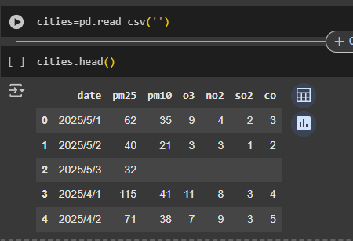
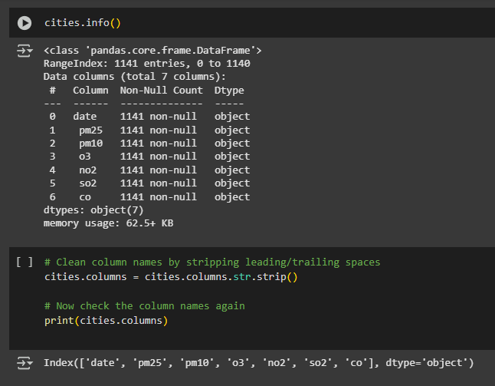
Code Snippets

Slide 10
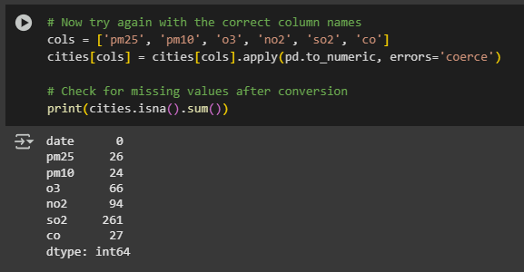
Checking for missing values

Slide 11
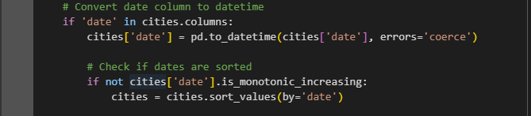

Arranging the dates (Ascending order)
Filling missing values

Slide 12
Data Cleaning and preprocessing [Colab]
https://colab.research.google.com/drive/1_tvciCkzi3ckYG9l_VwVUScepATrOMIZ#scrollTo=dmQ0L4yXyYVr
https://colab.research.google.com/drive/1elSwfzfWW3wS9_caj8LfvLmhyXQD6nco#scrollTo=fuEMhMuGYL2k

